Slide 1

Reveal the Main Factors and Adsorption Behavior Influencing the Adsorption of Pollutants on Natural Mineral Adsorbents: Based on Machine Learning Modeling and DFT Calculation
Mohammad Tanvir Ahmed
Department of Materials Science and Engineering

Slide 2
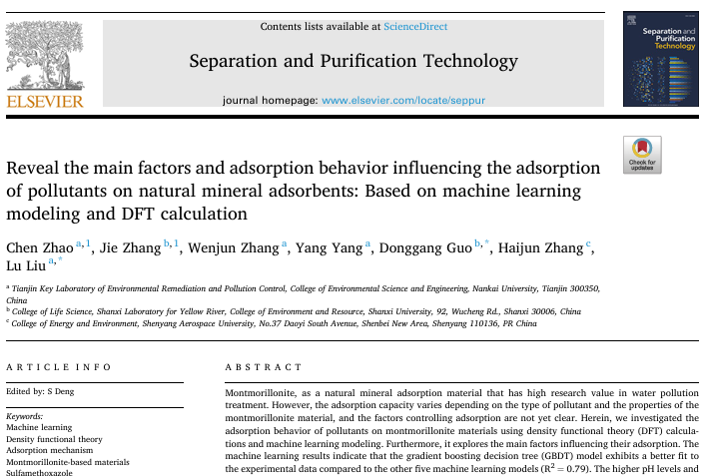

Slide 3
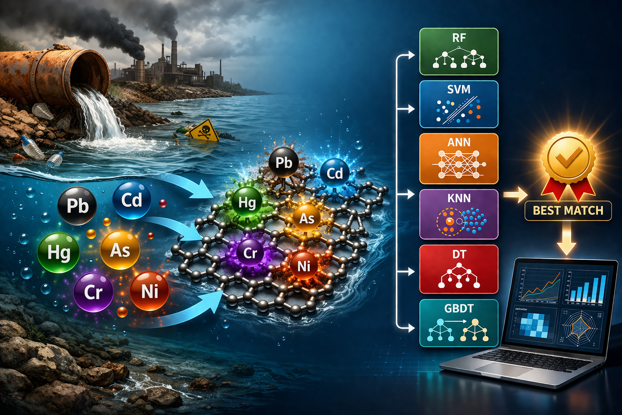
Introduction
Montmorillonite (MMN) is widely used for pollutant removal due to its layered structure and abundant adsorption sites.
Adsorption performance varies strongly with pollutant type and environmental conditions.
Traditional experimental + DFT approaches are time‑consuming and costly.
ML enables pattern discovery, feature importance, and rapid prediction.
Zhao, C., et al. Separation and Purification Technology 331 (2024): 125706.

Slide 4
Dataset Construction
84 papers (2013–2023) extracted from Web of Science.
1210 adsorption data points.
Pollutants include: Pb²⁺, Cd²⁺, Zn²⁺, Cu²⁺, dyes (MB, RhB, CV), antibiotics, phenols.
Data extracted directly from tables/figures; only unit conversion performed.
Input Variables
Material Properties: Surface area, pore volume, cation exchange capacity (CEC), and surface functional groups.
Pollutant Characteristics: Molecular weight, hydrophobicity, and functional groups.
Environmental Conditions: pH, temperature, and initial concentration.
Target Variable: Equilibrium adsorption capacity

Slide 5
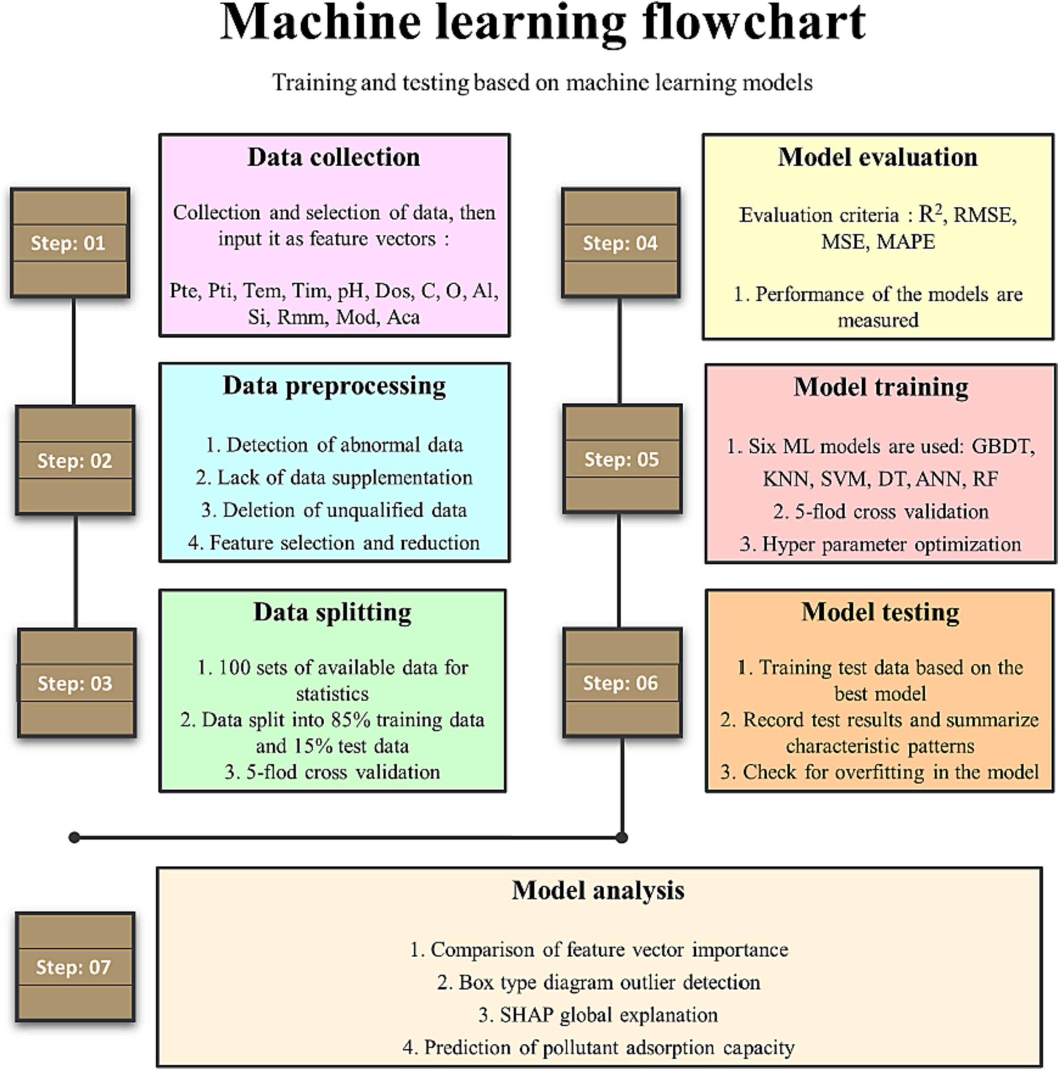
Data Preprocessing and Splitting
Missing values imputed using KNN (k = 5).
Outliers removed or corrected manually.
Data split: 70% training / 30% testing (best performance).
5‑fold cross‑validation for robustness.

Slide 6
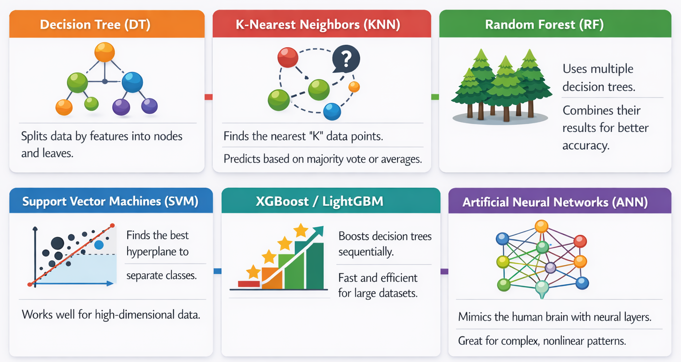
Selection of ML Algorithms
Notes:
Decision Tree (DT): Splits data based on feature thresholds to capture nonlinear relationships
K-Nearest Neighbors (KNN): Instance-based method that predicts values based on similarity to the nearest data points
Random Forest (RF): Effective for capturing non-linear relationships and providing feature importance.
Support Vector Machines (SVM): High performance in high-dimensional spaces.
XGBoost / LightGBM: Gradient boosting frameworks for high accuracy and speed.
Artificial Neural Networks (ANN): To model complex, deep-seated interactions.

Slide 7
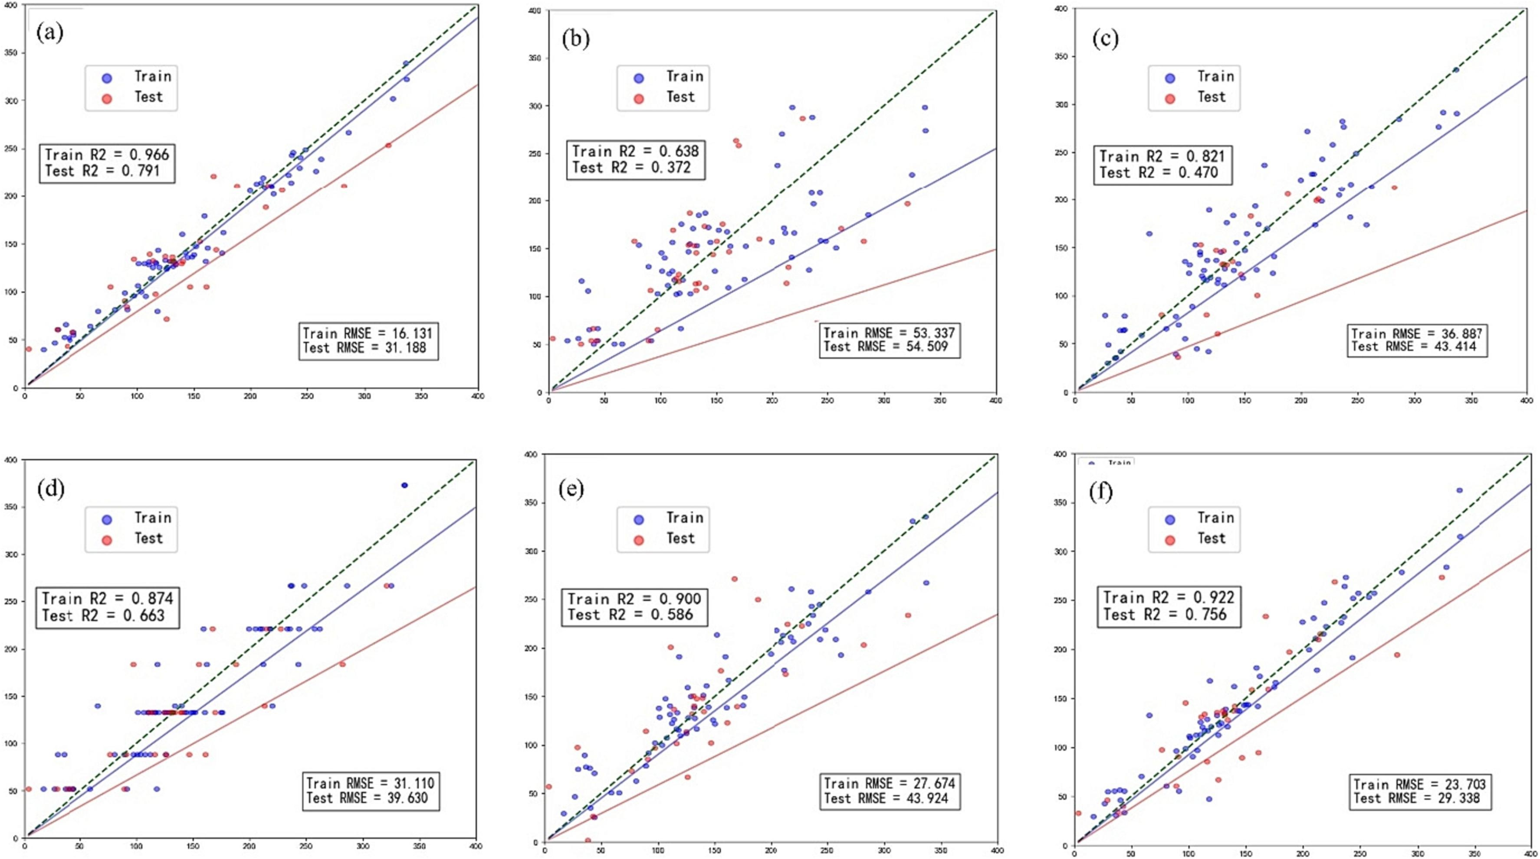
GBDT
KNN
SVM
DT
ANN
RF

Slide 8
Machine Learning Workflow
Models compared (Scikit‑Learn): GBDT, KNN, SVM, RF, DT, ANN.
Metrics: R², MSE, RMSE, MAPE on train and test.
Best model: GBDT
Train: R²=0.97, RMSE ≈ 16.1, MAPE 14.9%.
Test: R²=0.79, RMSE ≈ 31.2.
Interpretation: ensemble tree methods capture nonlinear relationships between environment, composition, and capacity.

Slide 9
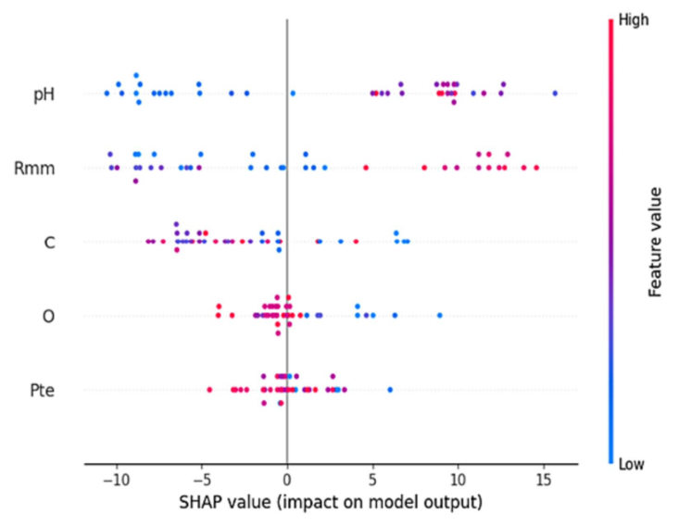
Key ML Findings
Adsorption is strongly governed by solution chemistry (pH)
Pollutant molecular size (Rmm) plays a major role.
Material surface composition (O, C).
Preparation conditions (Pte) significantly influence surface structure.
ML reveals nonlinear interactions not visible through simple correlations.
Fig.: Feature importance analysis
*SHAP →SHapley Additive exPlanations

Slide 10
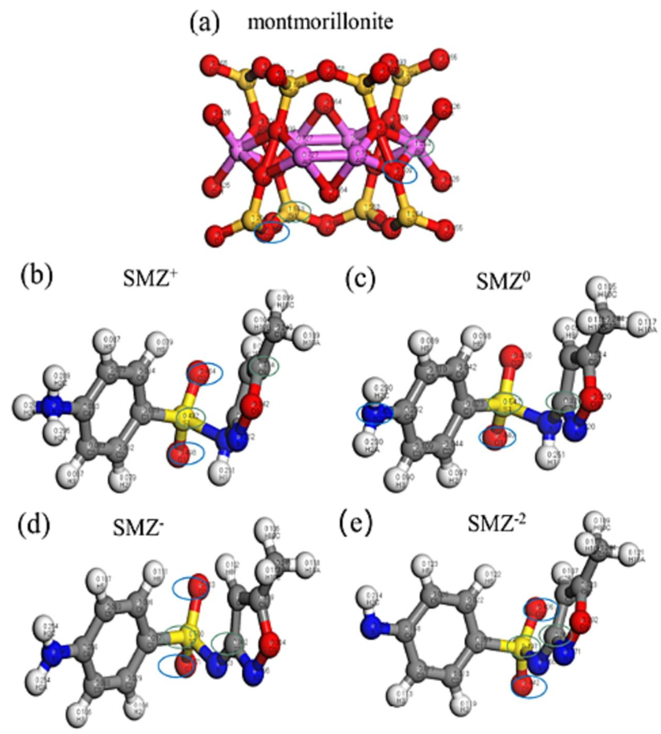
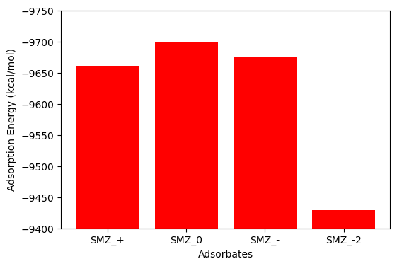
DFT Findings
Adsorption and removal of Sulfamethoxazole (SMZ) by montmorillonite studied under different pH conditions.
With deprotonation, positive charge decreased carried by SMZ molecules.
Fig.: Geometry of montmorillonite and SMZ
Fig.: Adsorption Energy with deprotonation

Slide 11
Conclusion
Built a robust ML framework using 1210 data points.
GBDT achieved the best predictive performance.
pH, Pte, O, Rmm, and C are the dominant factors.
ML + DFT provides a powerful hybrid approach for adsorption research.
Zhao, C., et al. Separation and Purification Technology 331 (2024): 125706.

Slide 12
Thank You

